Slide 1
Mission & Vision
Mission
Area Support Group - Poland (ASG-P) executes Base Operations Support Program tailored to the USAREUR theater ICW 297th RSG, in order to centralize base camp operations, improve quality of life support functions, and enhance operational readiness in support of the Regionally Allocated Forces within the Republic of Poland Area of Operations (AOO).
Vision
We are capable of integrating with the Joint Logistics Enterprise and our Polish Allies. We have built a structure that supports unit readiness for Atlantic Resolve (AR) rotational forces. We manage resources efficiently and equitably to support mission readiness and execution, and the well-being of service members and civilians.

Slide 2
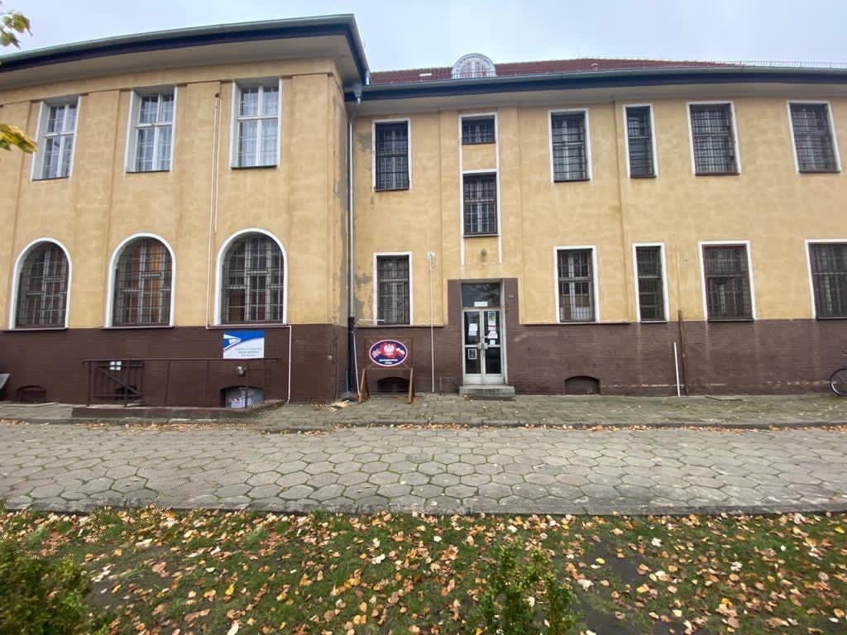
ASG-Poland Current Services
Directrorate of Human Resources
DEERS/RAPIDS (CAC) station
MWR equip ordering/coordination
Installation Postal operations
Poznan Educational Liaison
Security, Plans & Operations
EDCA Implementation
Operational contracting support
Host Nation Engagements
JPAS / Clearance verification
Anti-Terrorism & Force Protection
Physical Security assessment
Long Range Planning
Directorate of Logistics
Special Staff
GPC Agency Program Coordinator
Vehicle registration/de-registration
Housing support
Customs CCO support
Procurement support
Property Book support
Food Service assistance
GSA/TMP Fleet management
Transportation assistance
Container Management support
UIC/DODAAC assistance
MFAST Support
Legal services
Translation services
TRICARE Services
SARC/VA
Future Services of USAG Poland
Overseas Birth Status
Vehicle Processing Center
TRICARE Coordinator
DoDEA Coordinator
Education Center Coordinator
Directorate of Public Works
Facilities Engineering - Main Project tracker (DA 4283 requests, LOIs, LOJs)
Poland construction synchronization
Engineering input on project requests, charrettes, design reviews
Bridging Solutions ISO EDCA

